Slide 1
Chapter12. New specialized architectures
.
Blockchain architectures. Big Data architectures. AI-oriented systems. Secure software development for clouds and IoT: DevOps, SecOps, DevSecOps, secure microservices

Slide 2
Travel next week
Valparaiso, Chile (November 18-25)—12th Latin American Pattern Languages of Programs Conference, Valparaiso, Chile—Present three papers:
Rohini Sulatycki and E.B.Fernandez, “Two threat patterns that exploit ‘Cloud-based leaky buckets’ and ‘Malware-laden buckets’ ”
Virginia M. Romero and E.B. Fernandez "A Pattern for Controlled Access to a Cargo Port Terminal Physical Structure“
E.B.Fernandez and Jorge Forneron, "A security pattern for Zone Isolation using Virtual Processors in mobile and embedded systems“
I will also give a talk on my recent research

Slide 3
Blockchain architectures
A blockchain is an ordered list of blocks, where each block contains a list of transactions (possibly empty).
Each block is chained back to the previous block by containing a crypto hash of the previous block data
This means that transactions cannot be deleted or modified (the hash value would change)
Effectively, a blockchain is a decentralized ledger
Bitcoin is a digital currency that produced the first generation of blockchains, there are now many variants

Slide 4
Transactions and smart contracts
Transactions are data packages that store parameters (money…), and results of function calls (such as from smart contracts)
Smart contracts were introduced in the second generation of blockchains, e.g. Ethereum
They can express triggers, conditions, and business logic
An example of a smart contract is an escrow, which can hold release of funds until the obligations in the contract have been fulfilled

Slide 5
Blockchain [Swa14, XuX17, Zhe17]
Each block typically contains a crypto hash of the previous block, a timestamp and transaction data.
By design, a blockchain is inherently resistant to modification of the data. It is "an open, distributed ledger that can record transactions between two parties efficiently and in a verifiable and permanent way".
For use as a distributed ledger, a blockchain is typically managed by a peer-to-peer network collectively adhering to a protocol for inter-node communication and for validating new blocks.
Once recorded, the data in any given block cannot be altered retroactively without the alteration of all subsequent blocks, which requires collusion of the network majority.

Slide 6
Fundamental properties
Immutability. Committed transactions cannot be erased.
Non-repudiation. The immutable chain is a proof that cannot be denied.
Data integrity. Provided by cryptography
Data Transparency. Public access to the blocks (some blockchains are private)
Equal rights. Every participant has the same ability to access and manipulate the chain (but can be weighted)
No Replays. Addition of new items is controlled by a distributed consensus algorithm, which ensures that all transactions are validated, and that each valid transaction is added only once.

Slide 7
Block structure
With its previous block hash contained in the block header, a block has only one parent block.
The ﬁrst block of a blockchain is called genesis block, and has no parent block.
A Block consists of the block header and the block body as shown in Figure 2. In particular, the block header includes:

Slide 8
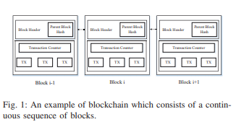

Slide 9
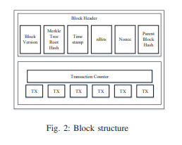

Slide 10
Block structure II
(i) Block version: indicates which set of block validation rules to follow.
(ii) Merkle tree root hash: the hash value of all the transactions in the block.
(iii) Timestamp: current time as seconds in universal time since January 1, 1970.
(iv) nBits: target threshold of a valid block hash.
(v) Nonce: an 4-byte ﬁeld, which usually starts with 0 and increases for every hash calculation (will be explained in detail)
(vi) Parent block hash: a 256-bit hash value that points to the previous block.
The block body is composed of a transaction counter and transactions. The maximum number of transactions that a block can contain depends on the block size and the size of each transaction.
Blockchain uses an asymmetric cryptography mechanism to validate the authentication of transactions.
Digital signatures are used in an untrustworthy environment.

Slide 11
Hash tree (Merkle Tree)
Every leaf node is labelled with the hash of a data block and every non-leaf node is labelled with the crypto hash of the labels of its child nodes.
Hash trees allow efficient verification of the contents of large data structures.
Advantages of tree over hashing concatenation of all messages: → Update of a single message requires only recalculation of hash values along path to root. → Verification of a message requires only knowledge of values in all direct children of nodes in path to root.

Slide 12
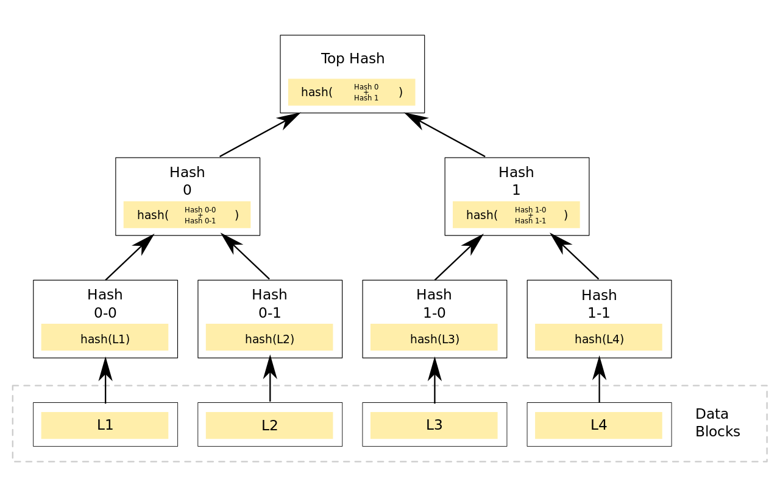

Slide 13
Blockchain components [Ell17]
Platforms - different implementations of the blockchain technology introduce diﬀerent approaches to privacy and smart contracts.
Actors - we want to know who the actors are and what roles they play in the given blockchain technology.
Services - what services are provided by the blockchain platform? Who interacts with the services (business level)?
Processes - what are the underlying processes to services? How do network, transaction and mining/consensus processes work?
Data models - what are the entities that hold information? What are the relationships between them?

Slide 14
Blockchain types
Permissionless - Fully public blockchains, where anyone can read and write.
Permissioned blockchain technology allows to deﬁne diﬀerent permissions on diﬀerent users on the network. There can be diﬀerent permissions for reading data, creating transactions, validating blocks, creating new ones and others.
Blockchains with Smart Contracts enable “smart contract” like capabilities and allow building business logic and business process mechanism into the chain.
Blockchains with transactions only are built for transaction capabilities. They support transferring value from one account to another.

Slide 15
Attributes of a Blockchain
Decentralization. In conventional centralized transaction systems, each transaction needs to be validated through the central trusted agency (e.g., the central bank), inevitably resulting to the cost and the performance bottlenecks at the central servers. In contrast to the centralized mode, third party is no longer needed in blockchain. Consensus algorithms are used to maintain data consistency in distributed networks.
Persistency. Transactions can be validated quickly and invalid transactions would not be admitted by honest miners. It is nearly impossible to delete or rollback transactions once they are included in the blockchain. Blocks that contain invalid transactions can be discovered immediately.

Slide 16
Attributes II
User Anonymity. Each user can interact with the blockchain with a generated address, which does not reveal the real identity of the user. Note that blockchain cannot guarantee the perfect privacy preservation due to the intrinsic constraint of public transactions
Auditability. Bitcoin blockchain stores data about user balances based on the Unspent Transaction Output (UTXO) model: Any transaction has to refer to some previous unspent transactions. Once the current transaction is recorded into the blockchain, the state of those referred unspent transactions switch from unspent to spent. So transactions can be easily veriﬁed and tracked.

Slide 17
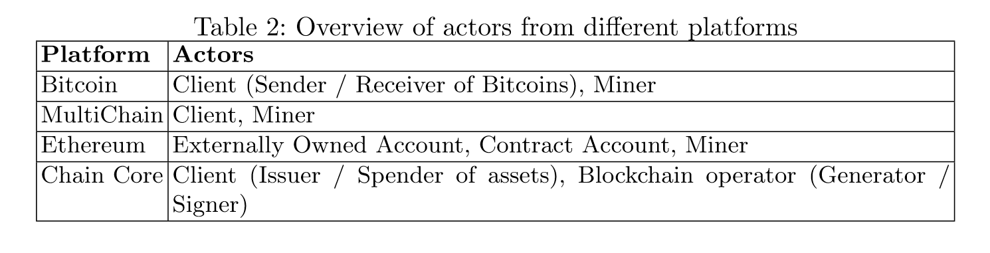

Slide 18
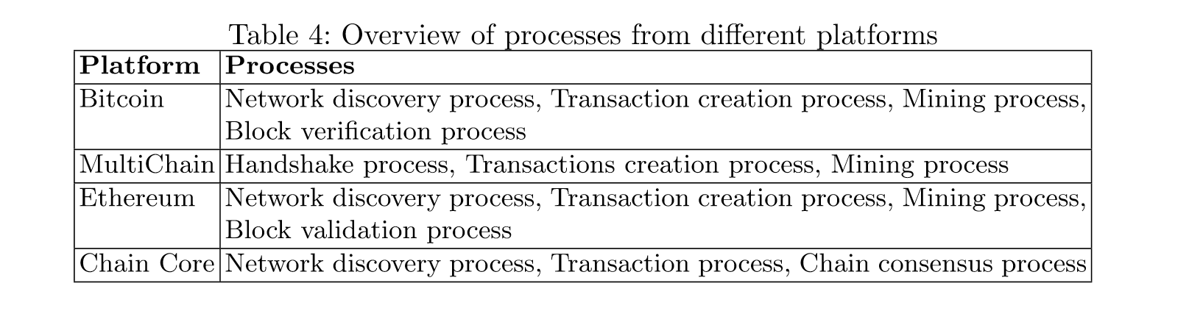

Slide 19
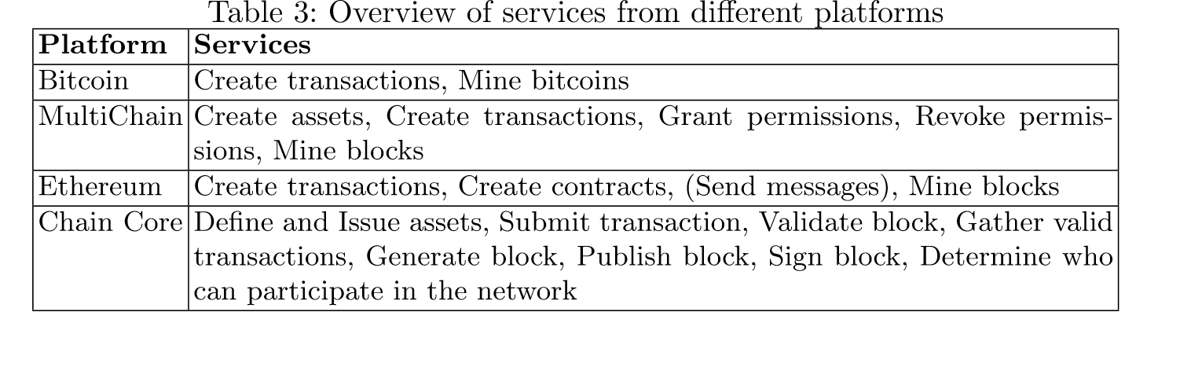

Slide 20
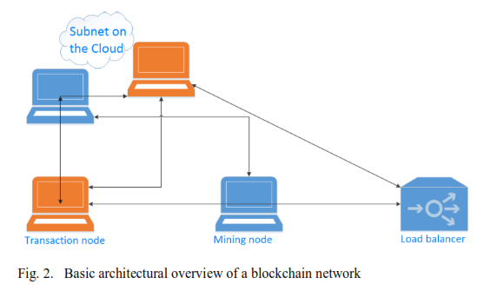

Slide 21
Architecture I
Transaction and Mining Nodes (compute) – Transaction nodes are used to execute smart contracts or submit transaction in the blockchain network, and mining nodes record transactions with the network and communicate with one another in the same subnet to come to a consensus on the underlying distributed ledger.
Load balancer (compute) – helps to maintain high availability, distributing requests appropriately among the transaction nodes in an availability set.

Slide 22
Architecture II
Network interfaces (network) – The network interfaces provide a means for communication within the virtual network and between the customer implemented client and the transaction nodes or LB. The LB exposes an RPC, SSH or HTTP endpoint allowing requests to be submitted and executed in the network.
Redundant storage (storage) – There is also a need for storage of the blockchain. CSPs typically provide either locally, or geographically redundant storage, needed particularly by the mining nodes to store the distributed ledger.

Slide 23
Node roles
There are two main roles for each node in the blockchain.
User - Actor who interacts with the blockchain by creating transactions.
Block generator - Human or system actor responsible for validation of transactions, building new blocks, signing new blocks and broadcasting new blocks to the blockchain. This actor can also provide consensus to support trust between the parties involved (proof-of-work, proof-of-stake etc).

Slide 24
ArchiMate
ArchiMate is an open and independent enterprise architecture modeling language to support the description, analysis and visualization of architecture within and across business domains in an unambiguous way.
ArchiMate is a technical standard from The Open Group and is based on the concepts of the IEEE 1471 standard. It is supported by various tool vendors and consulting firms. ArchiMate is also a registered trademark of The Open Group. The Open Group has a certification program for ArchiMate users, software tools and courses.
ArchiMate distinguishes itself from other languages such as Unified Modeling Language (UML) and Business Process Modeling and Notation (BPMN) by its enterprise modelling scope.

Slide 25
ArchiMate layers
The Business layer is about business processes, services, functions and events of business units. This layer "offers products and services to external customers, which are realized in the organization by business processes performed by business actors and roles".
The Application layer is about software applications that "support the components in the business with application services".
The Technology layer deals "with the hardware and communication infrastructure to support the Application Layer. This layer offers infrastructural services needed to run applications, realized by computer and communication hardware and system software".

Slide 26
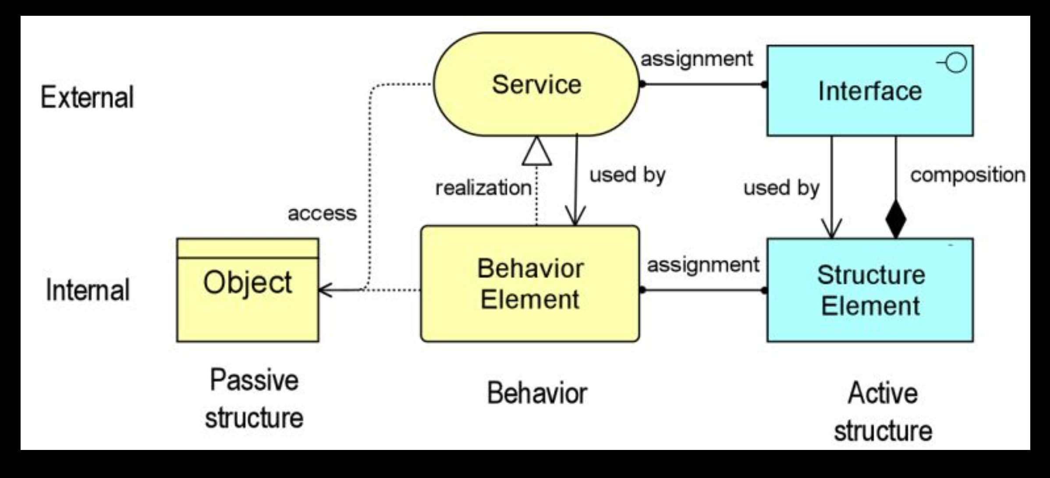
Core concepts

Slide 27
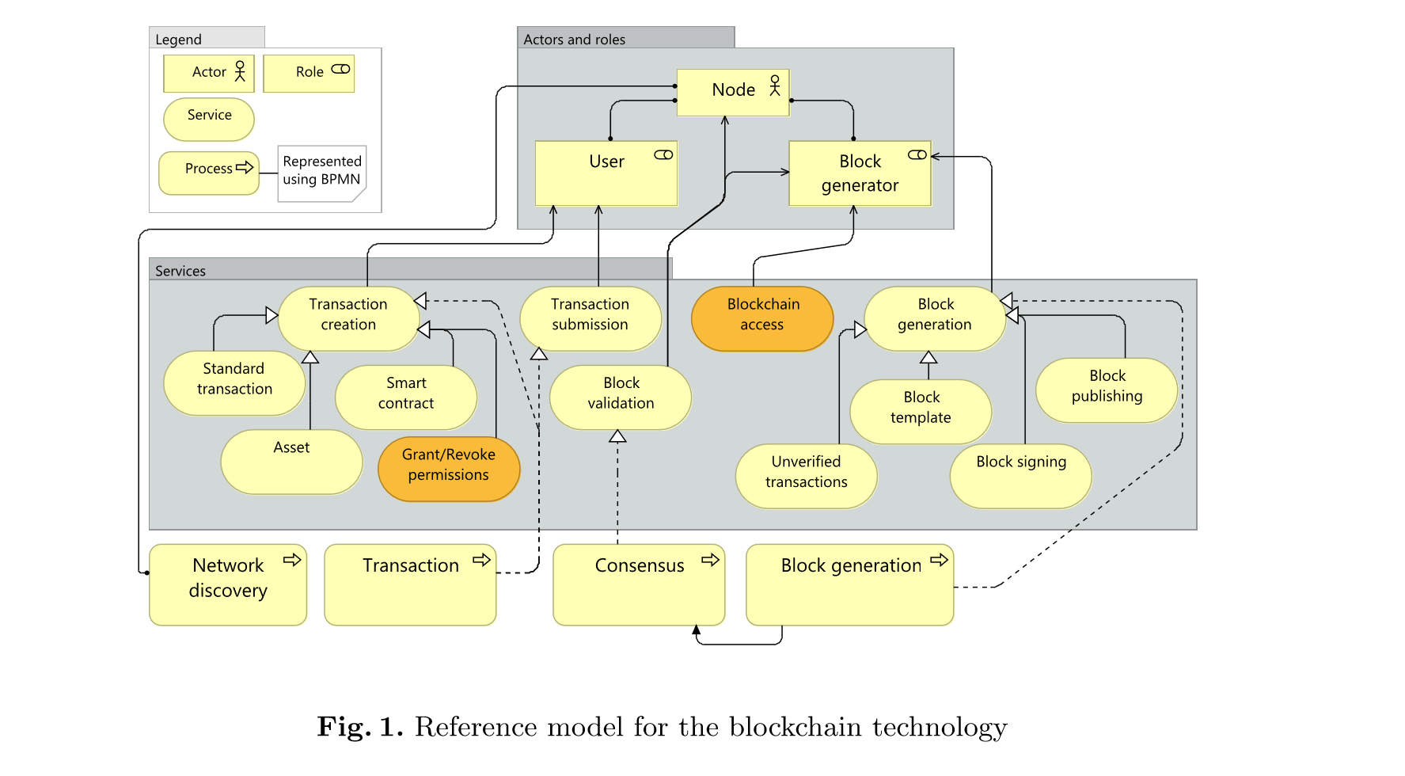

Slide 28
Workflows
A workflow describes a sequence of business tasks or activities to accomplish some business objective
The tasks must be orchestrated by a workflow engine (a process that monitors and manages the activities)
Similar to UML activity diagrams but simpler
There are several languages to describe workflows, such as BPEL, a standard for web services. A more general standard is BPMN

Slide 29
BPMN (Business Process Model and Notation) www.bpmn.org
An OMG standard, now in version 2.0
Intuitive to business users, yet able to represent complex process semantics
Also provides a mapping between the graphics of the notation and the underlying constructs of execution languages, particularly BPEL
Mapping to BPEL does not allow round-trip engineering because of semantic differences

Slide 30
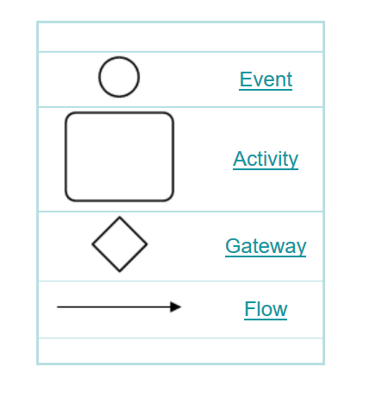
Basic symbols

Slide 31
BPMN definitions
Activity |  | Work that a company or organization performs using business processes. An activity can be atomic or non-atomic (compound). The types of activities that are a part of a Process Model are: Process, Sub-Process, and Task.
Business Process |  | A defined set of business activities that represent the steps required to achieve a business objective. It includes the flow and use of information and resources.
 | Choreography |  | An ordered sequence of B2B message exchanges between two or more Participants. In a Choreography there is no central controller, responsible entity, or observer of the Process.
Swimlane |  | A Swimlane is a graphical container for partitioning a set of activities from other activities. BPMN has two different types of Swimlanes. See “Pool” and “Lane.”
Task |  | An atomic activity that is included within a Process. A Task is used when the work in the Process is not broken down to a finer level of Process Model detail. Generally, an end-user, an application, or both will perform the Task. A Task object shares the same shape as the Sub-Process, which is a rectangle that has rounded corners.

Slide 32
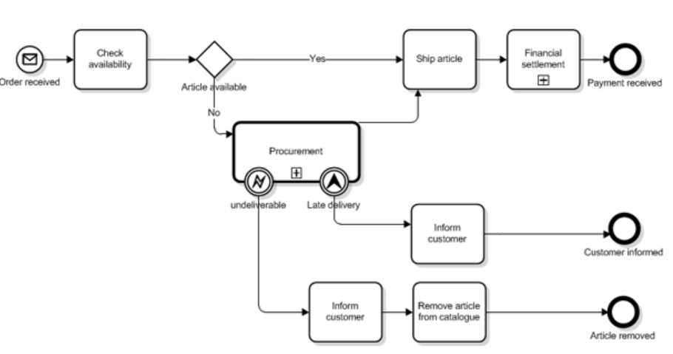
Example: order delivery

Slide 33
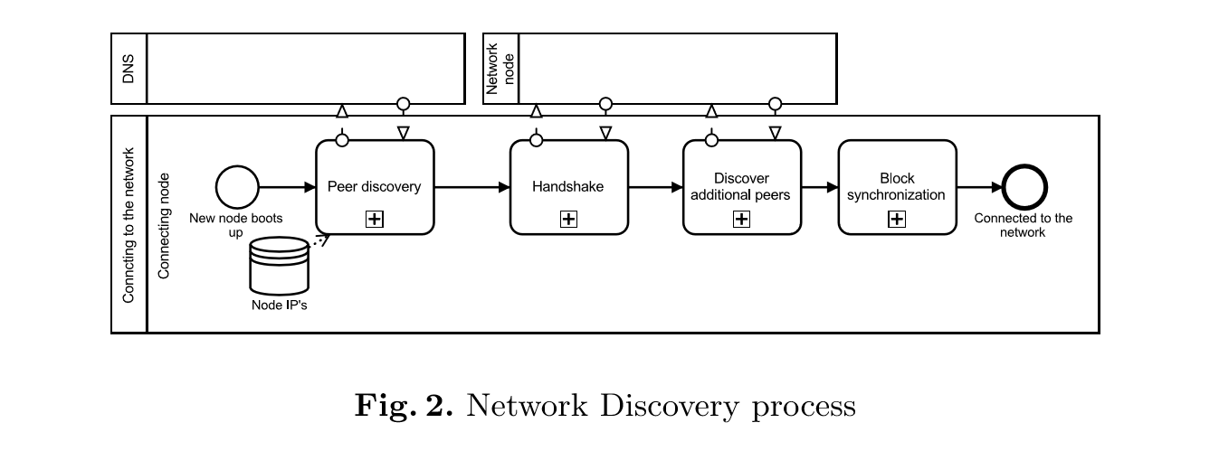

Slide 34
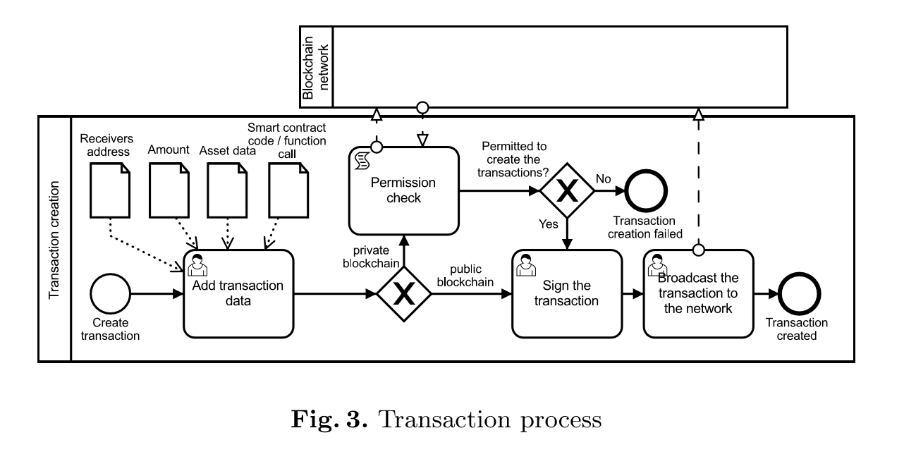

Slide 35
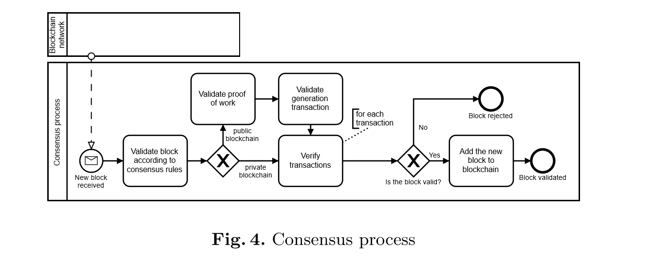

Slide 36
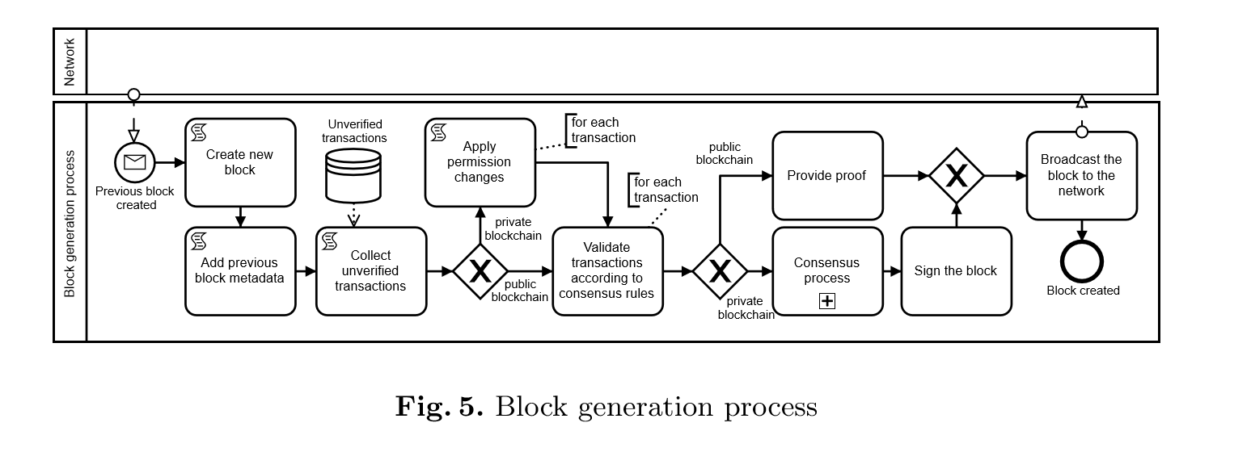

Slide 37
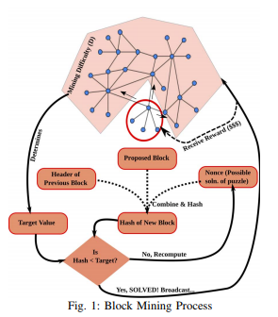

Slide 38
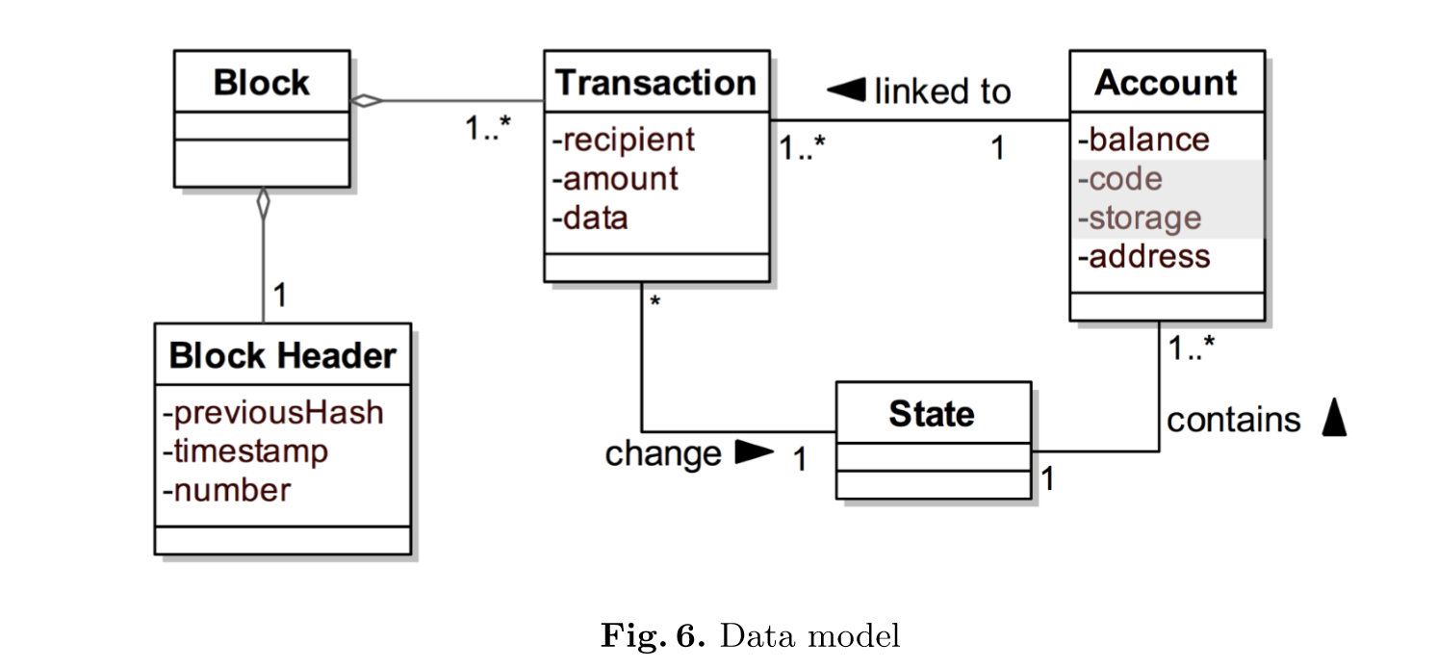

Slide 39
Consensus algorithms
How to reach consensus among the untrustworthy nodes is a variant of the Byzantine Generals (BG) Problem.
In this problem a group of generals who command a portion of Byzantine army circle a city. Some generals prefer to attack while other generals prefer to retreat.
However, the attack would fail if only part of the generals attack the city. Thus, they have to reach an agreement to attack or retreat.
How to reach a consensus in distributed environment is a challenge. It is also a challenge for blockchain as the blockchain network is distributed. In blockchain, there is no central node that ensures ledgers on distributed nodes, they are all the same.
Some consensus protocol is needed to ensure that ledgers in different nodes are consistent. Several common approaches to reach a consensus are shown in [Zhe17]. One is shown next.

Slide 40
Proof of Work (PoW) consensus algorithm
Used in bitcoin
A node of the distributed network is selected to record transactions (randomly or otherwise).
Each node calculates the hash value of the block header
The block header contains a nonce and miners would change this nonce frequently to get different hash values
Consensus requires that the calculated value must be equal or smaller than a given value
When a node reaches the target value it broadcasts it to the other nodes and they must confirm its correctness (validation)
The other nodes must append the validated node to their own blockchains

Slide 41
Research problems
Scalability—Each node has to keep all transactions to validate them; this also slows down the transaction rate, 7 TX/sec in bitcoin.
Privacy—User privacy can be preserved but not transactional privacy. Several anonymization schemes are being considered.
Selfish mining—Selfish miners can keep their mined blocks without broadcasting.

Slide 42
Cloud Blockchain as a Service (BaaS)
Microsoft
Hewlett Packard
Baidu
Oracle
IBM
SAP
Stratis
Tencent
Amazon AWS
Google

Slide 43
Uses of blockchain
Cryptocurrencies
Money Ledgers
Software architectural connector
Reliably collecting and preserving data used in science experiments
Trust issues in supply chain management
Reliable voting
Collection of data for smart cities
Cloud enabled IoT architecture
Smart home services and control

Slide 44
Security attacks
Cryptojacking
DDoS
Eclipse [Hei15]
Quantum [Agg18]

Slide 45
Cryptojacking https://nakedsecurity.sophos.com/2018/11/12/headmaster-fired-over-cryptocoin-mining-on-the-schools-dime/?utm_source=Naked+Security+-+Sophos+List&utm_campaign=505a541255-Naked+Security+daily+news+email&utm_medium=email&utm_term=0_31623bb782-505a541255-455135885
To make real money with coin mining, you need a lot of electricity to deliver a whole lot of processing power on a whole lot of computers.
You’ve got options: you can rent space in a giant coin mining server farm – for example, in Iceland, where electricity is cheap, the weather is cold enough to stop your computers from melting down, and where mining zapped more energy than households this year.
Then again, you can just steal other people’s electricity, by plugging into their outlets. But as those arrested for doing this will surely attest, that’s got the downside of being conspicuous.
That’s one reason why there’s arisen a newish form of malware called cryptojacking: the theft of electricity, processing power and air conditioning by inflicting malware that sneaks cryptominers into networks, browsers, coffee shops, and more.
More: https://www.sophos.com/en-us/medialibrary/PDFs/technical-papers/sophos-coinminer-and-other-malicious-cryptominers-tpna.aspx

Slide 46
DDoS attack on bitcoin
Bitcoin miners could have brought down the entire blockchain by flooding full node operators with traffic, via a Distributed Denial-of-Service (DDoS) attack.
“A denial-of-service vulnerability (CVE-2018-17144) exploitable by miners has been discovered in Bitcoin Core versions 0.14.0 up to 0.16.2.” “It is recommended to upgrade any of the vulnerable versions to 0.16.3 as soon as possible.”
Developers have issued a patch for anyone running nodes, along with an appeal to update the software immediately.
As far as the attack vector in question goes, there’s a catch: anyone trying to bring down Bitcoin would have to sacrifice almost $80,000 worth of Bitcoin in order do it.

Slide 47
Eclipse attack [Hei15]
The attacker monopolizes all of the victim’s incoming and outgoing connections, thus isolating the victim from the rest of its peers in the network.
The attacker can then filter the victim’s view of the blockchain, force the victim to waste compute power on obsolete views of the blockchain, or coopt the victim’s compute power for its own nefarious purposes.

Slide 48
Quantum attacks [Agg17]
Cryptocurrencies could be attacked using quantum computers.
This paper finds that the PoW used in Bitcoin is relatively resistant to attack by quantum computers
However, the elliptic curve signature used in Bitcoin is at risk and could be broken in about 10 years
An alternative PoW is proposed (Momentum), which is based on finding collisions in a hash function.

Slide 49
Big Data
Big Data implies a change compared to traditional techniques in three different ways:
the amount of data (volume),
the rate of generation and transmission of data (velocity)
the heterogeneity of the types of structured and unstructured data that it can handle (variety)
These properties are known as the three Vs of Big Data.

Slide 50
Components of the NIST RA
System Orchestrator (SO): it is one of the most important components of a Big Data ecosystem because it is the one in charge of defining and integrating the required data application activities into the ecosystem
The main purpose of this component is the configuration and management of the other components of the Big Data architecture.
In an enterprise, this function is typically centralized and can be mapped to the traditional role of system governor which provides the supervision of the requirements and constraints that the Big Data must fulfill; for example, policies, architecture, or business requirements.

Slide 51
Data Provider and Big Data Application Provider
Data Provider (DP): Oversees feeding the Big Data ecosystem with new data. In order to accomplish that goal, the Data Provider has a collection of interfaces, or services, between the Big Data and the data sources.
Big Data Application Provider (BDAP): Executes a specific set of services along the data life cycle to meet the requirements established by the SO. Its main purpose is to encapsulate the business logic and functionality to be executed by the architecture. In a regular Big Data scenario, there are several applications executing over the same data. As data propagates through the ecosystem, it is being processed and transformed in different ways to obtain valuable information from the data. In order to achieve that goal, the BDAP is composed of different services or activities that can be considered as the SaaS layer of the Big Data system. These activities are: collection, preparation, analytics, visualization, and access.

Slide 52
Big Data Framework Provider and Data Consumer
Big Data Framework Provider (BDFP): It can be considered as the platform implementation of the Big Data logic. It supports the activities defined in the BDAP. Big Data implementations are hybrids that combine multiple technologies. It has three main activities: infrastructure (virtual or physical), platform (how the data is distributed and organized), and processing (how data will be processed to support Big Data applications).
Data Consumer (DC): It is similar to the DP component. Usually the actor that interacts with this component is an end-user or another system. Similarly to the DP, it is composed of a set of interfaces between the end-user and the information.

Slide 53
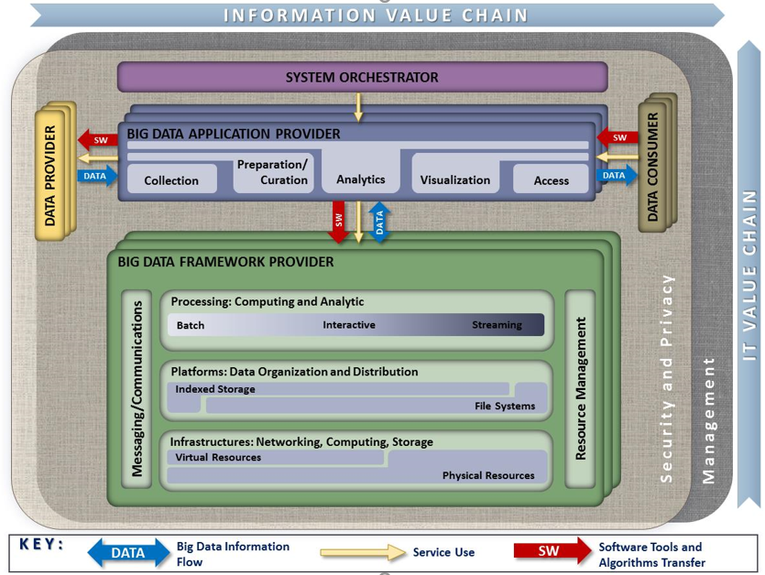
NIST RA
Notes:
General architecture
Taking into account different proposals e.g. Oracle.
Different Components:
System Orchestrator (SO)
Data Provider (DP)
Big Data Application Provider (BDAP)
Big Data Framework Provider (BDFP)
Data Consumer (DC)
Activities and actors

Slide 54
NIST RA limitations
The NIST proposal cannot be considered a SRA, but it recognizes the importance of security and privacy in a Big Data environment.
In order to face the security problems, this architecture has a Security and Privacy Fabric that addresses the needs and solutions about this specific topic.
From our point of view, this representation based on blocks is not expressive enough. This kind of specification is too high level in terms of the abstraction it provides, which has little emphasis on details of the subcomponents and how they are connected.
This approach can make difficult the design and implementation of a Big Data ecosystem.
The ISO/IEC organization is also working in the creation of a RA for Big Data under the standard ISO/IEC 20547-3. Although, it is a work in progress, it is expected that it will follow a similar approach to the NIST proposal.
The following diagrams show our model

Slide 55
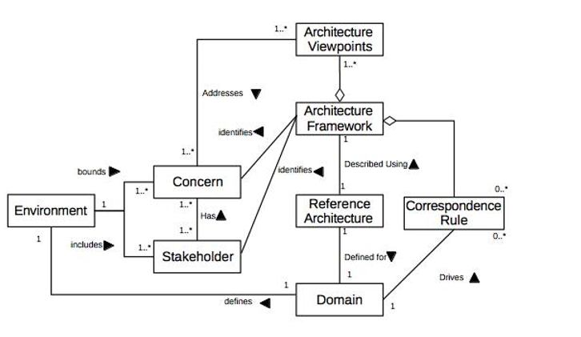
ISO/IEC 20547-3

Slide 56
Big Data architecture components [Mor18a]
System Orchestrator (SO): it is the one in charge of defining and integrating the required data application activities into the ecosystem. The main purpose of this component is the configuration and management of the other components of the Big Data architecture.
Data Provider (DP): This component oversees feeding the Big Data ecosystem with new data. In order to accomplish that goal, the Data Provider has a collection of interfaces, or services, between the Big Data and the data sources.
Big Data Application Provider (BDAP): provides a specific set of services along the data life cycle to meet the requirements established by the SO. its main purpose is to encapsulate the business logic and functionality to be executed by the architecture.

Slide 57
Big Data Components II
Big Data Framework Provider (BDFP): can be considered as the platform implementation of the Big Data logic. It supports the activities defined in the BDAP. It has three main activities: infrastructure (virtual or physical), platform (how the data is distributed and organized), and processing (how data will be processed to support Big Data applications). In addition, the BDFP component also provides the support services for the system like communications or resource management.
Data Consumer (DC): It is similar to the DP component. Usually the actor that interacts with this component is an end-user or another system.

Slide 58
System orchestrator

Slide 59
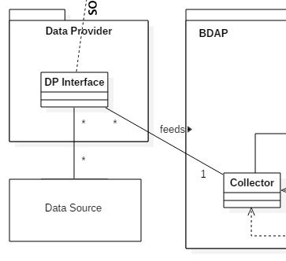
Data Provider

Slide 60
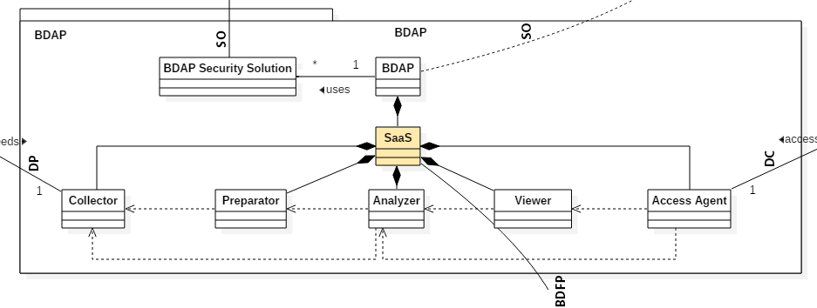
Big Data Application Provider

Slide 61
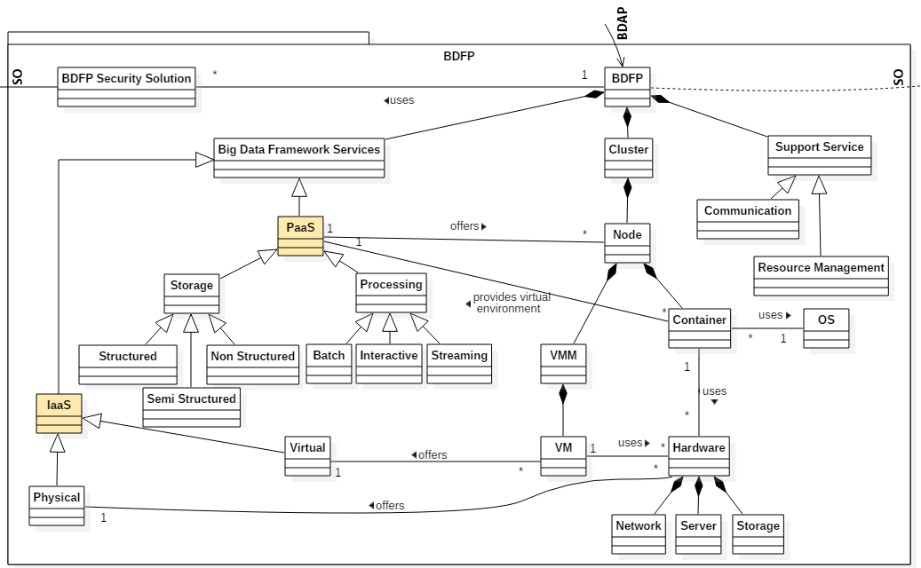
Big Data Framework Provider

Slide 62
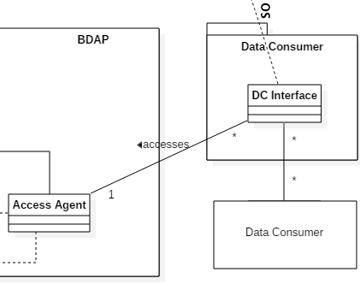
Data consumer

Slide 63
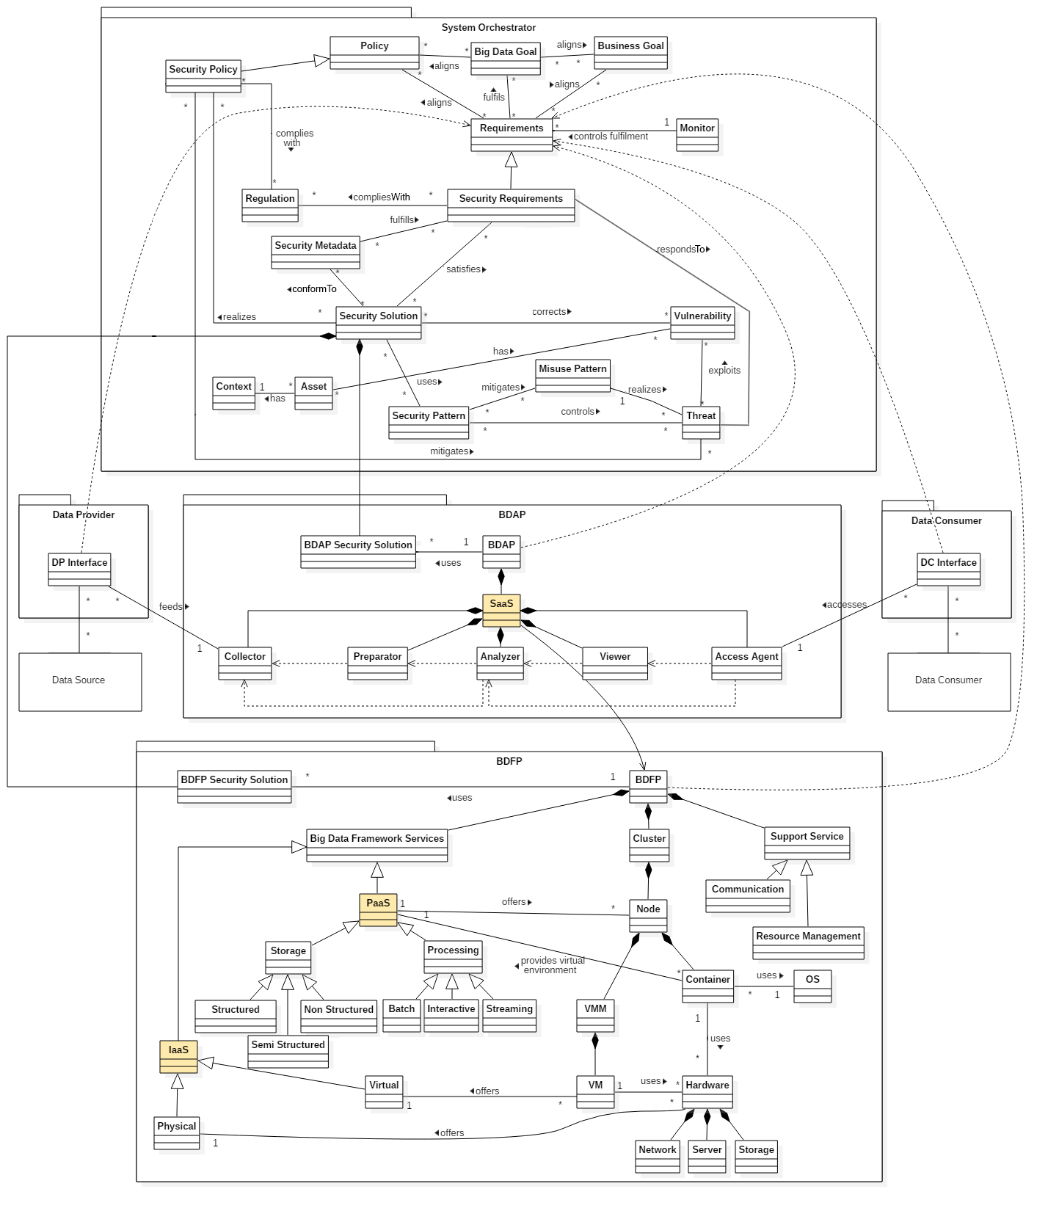

Slide 64
Possible threats
ID | Activity | Threat | Security Pattern
TC1 | Common to all the activities | Data modified | Authentication, Role-based access control
TC2 | Common to all the activities | Data destroyed | Authentication, Role-based access control
TC3 | Common to all the activities | Data illegally read | Encryption, Role-based access control, Authentication
TC4 | Common to all the activities | Unapproved change in activity function | Logger and Auditor, Controlled access session, Role-based access control, Authentication
TCo1 | Collection | Malicious data source | Authentication

Slide 65
More threats
*PII – Personal Identifiable Information
TP1 | Preparation | Malicious filter | Logger and Auditor, Controlled access session, Role-based access control, Authentication
TA1 | Analysis | Infer PII* from anonymized data | Encryption, Logger and Auditor, Multilevel security, Role-based access control, Authentication
TA2 | Analysis | Malicious analysis algorithms | Logger and Auditor, Controlled access session, Role-based access control, Authentication
TV1 | Visualization | PII* exposed due to high graphic granularity | Multilevel security, Authentication, Role-based access control
TAc1 | Access | Several malicious access | Authentication, Role-based access control

Slide 66
Conclusions from model
A more precise Reference Architecture (RA) is a better framework to guide the use of security mechanisms. With a UML diagram it is possible to conveniently apply security patterns, which are usually described as UML models.
Our Security Reference Architecture (SRA) subsumes the published RAs, including the proposals made by NIST, Oracle, NTT, and some researchers.
We have defined some of the security patterns that can be implemented to protect the system against threats. We have also listed some of the threats that can be found in a Big Data ecosystem

Slide 67
A pattern for Key-value authorization [Mor18b]
Most non-SQL databases for Big Data applications use a new model appropriate to their structure, speed, and large amount of data.
This model protects each individual cell in key-value databases; each data value is labeled with authorization rights following a Role-Based Access Control model or similar
All the known examples are derived from the security model of Apache Accumulo, which in turn received it from an NSA project.
Known examples include Koverse, SQRRL, and Blue Talon databases

Slide 68
Bruce Schneier schneier@schneier.com http://www.schneier.com
Top emerging threats in cyberspace.
The Rise of Big Data. By this I mean industries that trade on our data. These include traditional credit bureaus and data brokers, but also data-collection companies like Facebook and Google. They're collecting more and more data about everyone, often without their knowledge and explicit consent, and selling it far and wide: to both other corporate users and to government. Big data is becoming a powerful industry, resisting any calls to regulate its behavior.
Ill-Conceived Regulations from Law Enforcement. We're seeing increasing calls to regulate cyberspace in the mistaken belief that this will fight crime. I'm thinking about data retention laws, Internet kill switches, and calls to eliminate anonymity. None of these will work, and they'll all make us less safe.

Slide 69
Dynamic software
Systems are becoming more and more dynamic: new applications, new devices, system upgrades,…
We need architectures for ease of change and adaptation
This may require the ability to dynamically discover and compose services and resources
For other systems it may require well-defined interfaces that support rapid customization, extension, and upgrade
The changes should not interfere with the current services

Slide 70
Describing and reasoning about the architecture
We need a way to characterize the set of all possible systems, which cannot be done with existing description languages
It is very difficult to do a formal analysis of future system configurations
Partial solutions may come from the application of product line variability representation and analysis
All this work is worthwhile because we could produce systems that collaborate in ensuring their own health and quality
These are called self-adaptive systems or autonomic systems

Slide 71
Self-adaptive systems
An important approach to self-adaptation is to adopt a control systems view.
We add in each system a control layer, responsible for monitoring the state of the system, detecting opportunities for improvement, and effecting change in as it runs
Architectural models are very useful for this purpose
Now architectural models become useful not only as design artifacts, but as run-time artifacts as well

Slide 72
IBM Autonomic framework
1. Monitor: The monitoring phase is concerned with extracting information – properties or states – out of the managed element.
2. Analyze: is concerned with determining if something has gone awry in the system, usually because a system property exhibits a value outside of expected bounds, or has a degrading trend.
3. Plan: is concerned with determining a course of action to adapt the managed element once a problem is detected.
4. Execute: is concerned with carrying out a chosen course of action and effecting the changes in the system.
Shared between these four phases is the Knowledge component, which contains models, data, and plans or scripts to enable separation of adaptation responsibilities and coordination of adaptations

Slide 73
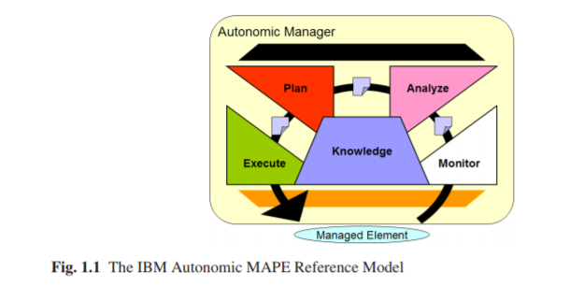

Slide 74
The Rainbow framework [Gar09]
What is missing is an approach to self-adaptation that (a) is generally applicable to different classes of systems and quality objectives, (b) allows adaptation to be represented as explicit operational entities and chooses the best one in a principled and analyzable way, and (c) provides an integrated approach that saves engineers time and effort in writing and changing adaptation.
This approach satisfies the above requirements by: (1) providing a framework, called Rainbow, that provides general, supporting mechanisms for self-adaptation, and which can be tailored to different classes of systems; and (2) defining a language, called “Stitch,” that plugs into this framework and allows adaptation expertise to be specified and reasoned about, and which can be used to automate and coordinate adaptations to satisfy multiple objectives.

Slide 75
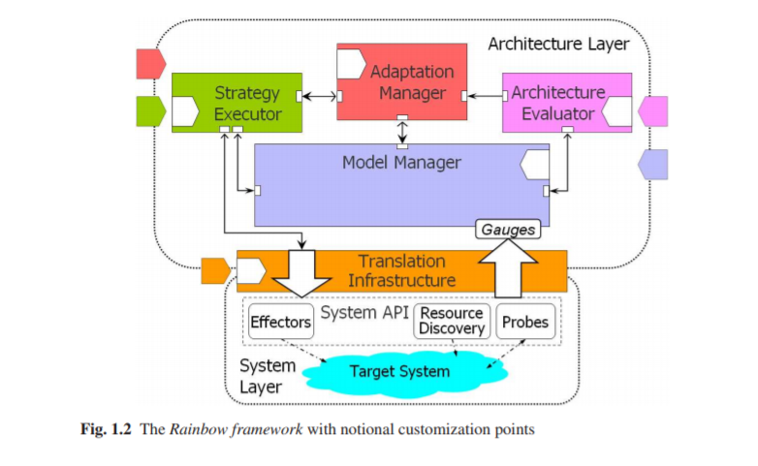

Slide 76
Structure of the Rainbow framework
Monitoring mechanisms—probes and gauges—observe the running target system.
Observations are reported to update properties of the architecture model managed by the Model Manager.
The Architecture Evaluator evaluates the model upon update to ensure that the system is operating within an acceptable range, as determined by architectural constraints.
If the evaluation determines that the system has a problem, the Evaluator triggers the Adaptation Manager to initiate the adaptation process and choose an appropriate repair strategy.
The Strategy Executor executes the strategy on the running system via system-level effectors.
The next figure shows a more detailed view.

Slide 77
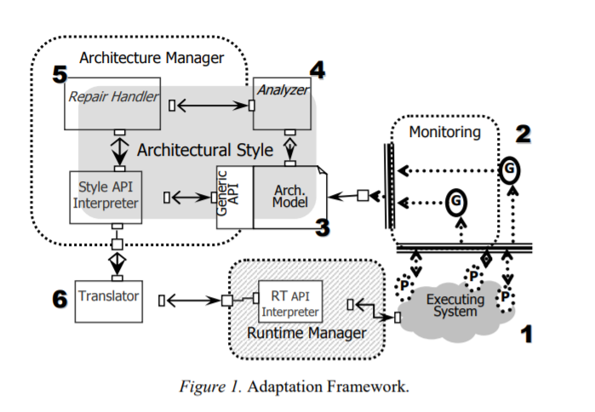

Slide 78
AI Genome; The main aspects of interests and stakeholders around evolution of AI systems [Adp18]
The way towards wider/general purpose AI systems envisions very different kind of systems; Systems autonomously maintaining themselves, operating, learning and interacting over extended periods as part of society and culture, as presented in the vision of Software Social Organisms.
Advanced AI systems may highly differ from the existing software intensive systems (in terms of applicable methodologies, underlying technologies, organization, development, training, operation, maintenance, governance and way of interaction) suggests that an architecture framework for AI systems would be beneficial for analysis and development these systems – both for industry and academia.
We take a step towards such an architecture framework for AI systems and discuss the potential benefits it could provide for the R&D community.

Slide 79
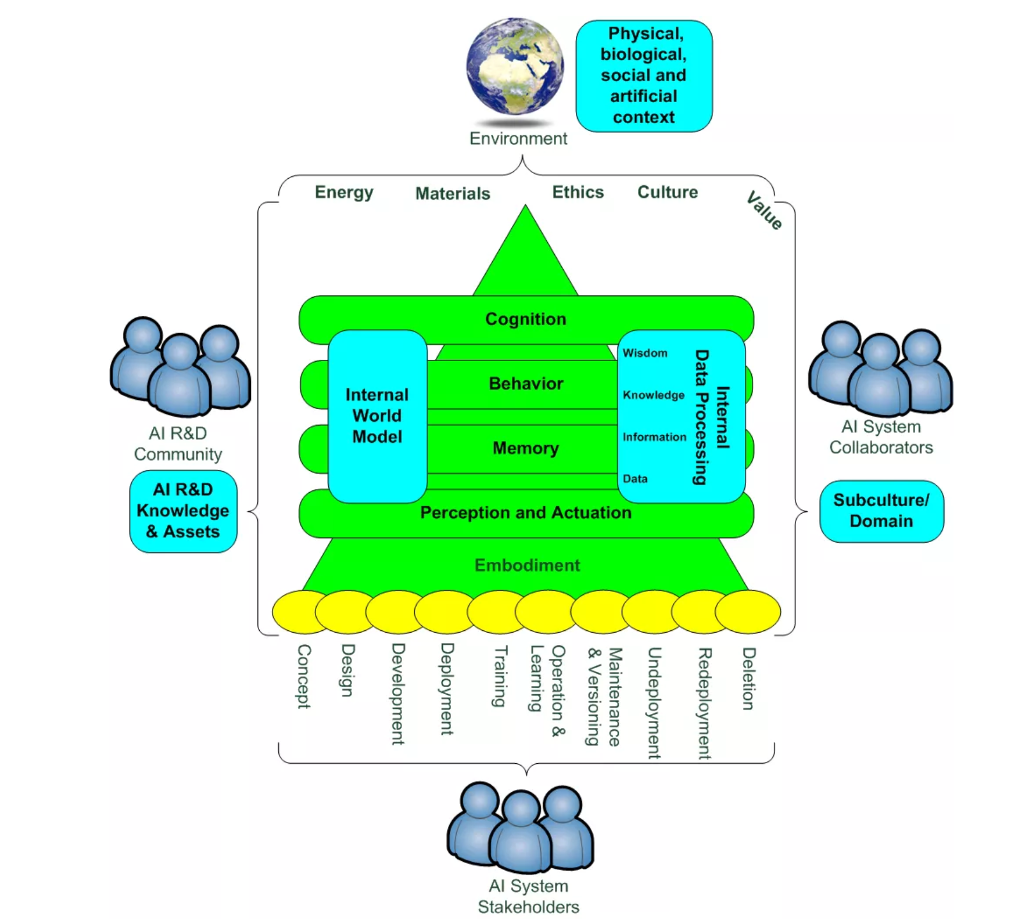
AI Genome; The main aspects of interests and stakeholders around evolution of AI systems

Slide 80
Top Experts Warn Against 'Malicious Use' of AI By AFP on February 21, 2018
Artificial intelligence could be deployed by dictators, criminals and terrorists to manipulate elections and use drones in terrorist attacks, more than two dozen experts said Wednesday as they sounded the alarm over misuse of the technology.
In a 100-page analysis, they outlined a rapid growth in cybercrime and the use of "bots" to interfere with news gathering and penetrate social media among a host of plausible scenarios in the next five to 10 years.
"Our report focuses on ways in which people could do deliberate harm with AI," said Seán Ó hÉigeartaigh, Executive Director of the Cambridge Centre for the Study of Existential Risk.

Slide 81
AI II
"AI may pose new threats, or change the nature of existing threats, across cyber-, physical, and political security," he told AFP.
The common practice, for example, of "phishing" -- sending emails seeded with malware or designed to finagle valuable personal data -- could become far more dangerous, the report detailed.
Currently, attempts at phishing are either generic but transparent -- such as scammers asking for bank details to deposit an unexpected windfall -- or personalised but labour intensive -- gleaning personal data to gain someone's confidence, known as "spear phishing".

Slide 82
AI III
"Using AI, it might become possible to do spear phishing at scale by automating a lot of the process" and making it harder to spot, O’Eigeartaigh noted.
In the political sphere, unscrupulous or autocratic leaders can already use advanced technology to sift through mountains of data collected from omnipresent surveillance networks to spy on their own people.
"Dictators could more quickly identify people who might be planning to subvert a regime, locate them, and put them in prison before they act," the report said.

Slide 83
AI IV
Likewise, targeted propaganda along with cheap, highly believable fake videos have become powerful tools for manipulating public opinion "on previously unimaginable scales".
An indictment handed down by US special prosecutor Robert Mueller last week detailed a vast operation to sow social division in the United States and influence the 2016 presidential election in which so-called "troll farms" manipulated thousands of social network bots, especially on Facebook and Twitter.
Another danger zone on the horizon is the proliferation of drones and robots that could be repurposed to crash autonomous vehicles, deliver missiles, or threaten critical infrastructure to gain ransom.

Slide 84
AI V
Autonomous weapons -
"Personally, I am particularly worried about autonomous drones being used for terror and automated cyberattacks by both criminals and state groups," said co-author Miles Brundage, a researcher at Oxford University's Future of Humanity Institute.
The report details a plausible scenario in which an office-cleaning SweepBot fitted with a bomb infiltrates the German finance ministry by blending in with other machines of the same make.
The intruding robot behaves normally -- sweeping, cleaning, clearing litter -- until its hidden facial recognition software spots the minister and closes in.
"A hidden explosive device was triggered by proximity, killing the minister and wounding nearby staff," according to the sci-fi storyline.
"This report has imagined what the world could look like in the next five to 10 years," Ó’Éigeartaigh said.
"We live in a world fraught with day-to-day hazards from the misuse of AI, and we need to take ownership of the problems."
The authors called on policy makers and companies to make robot-operating software unhackable, to impose security restrictions on some research, and to consider expanding laws and regulations governing AI development.

Slide 85
AI VI
Giant high-tech companies -- leaders in AI -- "have lots of incentives to make sure that AI is safe and beneficial," the report said.
Another area of concern is the expanded use of automated lethal weapons.
Last year, more than 100 robotics and AI entrepreneurs -- including Tesla and SpaceX CEO Elon Musk, and British astrophysicist Stephen Hawking -- petitioned the United Nations to ban autonomous killer robots, warning that the digital-age weapons could be used by terrorists against civilians.
"Lethal autonomous weapons threaten to become the third revolution in warfare," after the invention of machine guns and the atomic bomb, they warned in a joint statement, also signed by Google DeepMind co-founder Mustafa Suleyman.
"We do not have long to act. Once this Pandora's box is opened, it will be hard to close."
Contributors to the new report -- entitled "The Malicious Use of AI: Forecasting, Prevention, and Mitigation" -- also include experts from the Electronic Frontier Foundation, the Center for a New American Security, and OpenAI, a leading non-profit research company.
"Whether AI is, all things considered, helpful or harmful in the long run is largely a product of what humans choose to do, not the technology itself," said Brundage.

Slide 86
Secure software development for clouds and IoT.
DevOps, SecOps, secure microservices.

Slide 87
Rapid software development
Rapid development and delivery is now often the most important requirement for software systems
Businesses operate in a fast –changing requirement and it is practically impossible to produce a set of stable software requirements
Software has to evolve quickly to reflect changing business needs.
Plan-driven development is essential for some types of system but does not meet these business needs.
Agile development methods emerged in the late 1990s whose aim was to radically reduce the delivery time for working software systems

Slide 88
Agile development
Program specification, design and implementation are inter-leaved
The system is developed as a series of versions or increments with stakeholders involved in version specification and evaluation
Frequent delivery of new versions for evaluation
Extensive tool support (e.g. automated testing tools) used to support development.
Minimal documentation – focus on working code

Slide 89
Plan-driven and agile development

Slide 90
Plan-driven and agile development
Plan-driven development
A plan-driven approach to software engineering is based around separate development stages with the outputs to be produced at each of these stages planned in advance.
Not necessarily waterfall model – plan-driven, incremental development is possible
Iteration occurs within activities.
Agile development
Specification, design, implementation and testing are inter-leaved and the outputs from the development process are decided through a process of negotiation during the software development process.

Slide 91
DevOps
DevOps (development = operations) is a a software development methodology that combines software development (Dev) with IT operations (Ops).
The goal of DevOps is to shorten the systems development life cycle while also delivering features, fixes, and updates frequently in close alignment with business objectives.
The DevOps approach is to include automation and event monitoring at all steps of the software
DEvOps stresses communication, collaboration, integration, automation, and measurement of cooperation between developers and other (IT) professionals.
The specific goals of a DevOps approach span the entire delivery pipeline. They include improved deployment frequency, which can lead to faster time to market, lower failure rate of new releases, shortened lead time between fixes, and faster mean time to recovery in the event of a new release crashing or otherwise disabling the current system.
Increased use of tools is another aspect

Slide 92
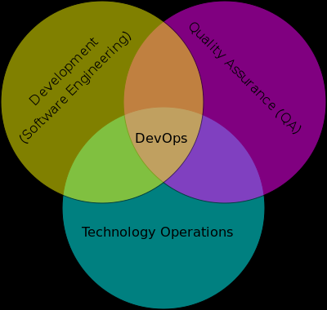
DevOps relationships

Slide 93
Microservices
A basic element that results from the architectural decomposition of an application’s components into loosely coupled patterns consisting of self contained services that communicate with each other using a standard communications protocol and a set of well-defined APIs, independent of any vendor, product or technology.
Microservices are built around capabilities as opposed to services, build on SOA and are implemented using Agile techniques.
Microservices are typically deployed inside Application Containers.

Slide 94
Containers and Microservices
Another reason for the popularity of containers is its support for microservices architectures.
“Microservices architectural style is an approach to developing a single application as a suite of small services, each running in its own process and communicating with lightweight mechanisms, often an HTTP resource API. These services are built around business capabilities and independently deployable by fully automated deployment machinery. There is a bare minimum of centralized management of these services, which may be written in different programming languages and use different data storage technologies.” (Fowler and Levis 2014)
Container technology has led to the evolution from monolithic architecture to microservices architecture.
Microservices architecture needs lightweight mechanisms, small independently deployable services, scalability and portability (Ekici 2014).
These requirements can be met by using containers.

Slide 95
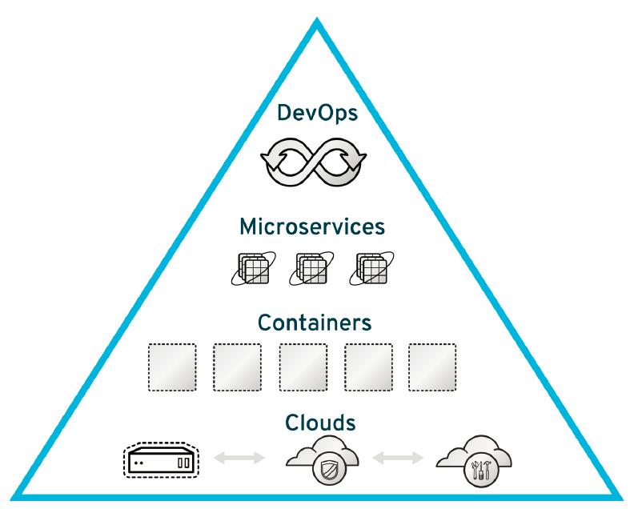
Containers support for Microservices and DevOps teams
A microservice architecture allows development of an application as a collection of small services which run in their own separate process and communicate with each other using lightweight mechanisms, such as HTTP resource API. These services are independently deployed by using container clusters that can be centrally managed.
Containers facilitate the work of DevOps teams by allowing the use of code to automatically perform infrastructure management tasks. A desired state is specified by changing configurations and this state is then automatically applied to the environment.
automate infrastructure management tasks:
optimizes resource utilization
Grouping
load balancing
auto-scaling
auto-healing
needs
lightweight mechanisms
small independently deployable services
scalability
portability
Figure 1. Pyramid of Modern Enterprise Development [Bryant 2015]

Slide 96
SecOps
SecOps is a collaboration between security and operations teams, just like development and operations teams collaborate on DevOps front. SecOps is a set of practices organizations need to follow, processes they need to execute and tools they need to use to ensure the security of their application environment. SecOps is making sure organizations do not sacrifice security to attain set performance and uptime indexes.
In a typical development cycle—requirements gathering, design, development, testing, implementation or deployment and maintenance—security normally is introduced in the later stages, somewhere between testing and deployment or even later. But SecOps is all about making sure to introduce aspects around security much earlier or at each stage of the software development life cycle (SDLC).

Slide 97
DevSecOps
DevSecOps strives to automate core security tasks by embedding security controls and processes into the DevOps workflow.
DevSecOps originally focused primarily on automating code security and testing, but now it also encompasses more operations-centric controls.

Slide 98
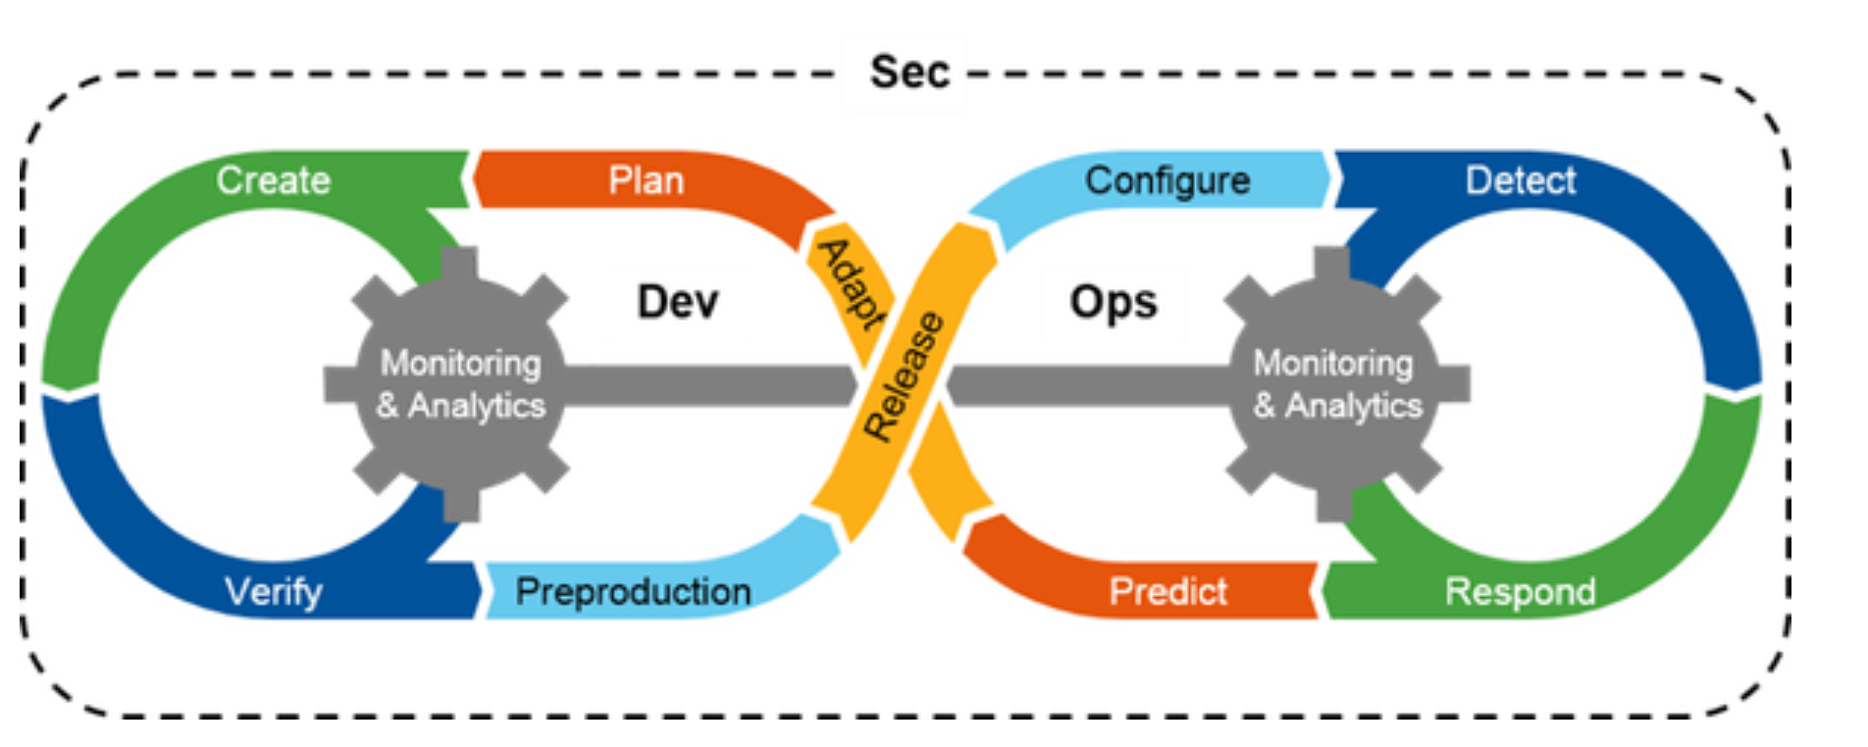

Slide 99
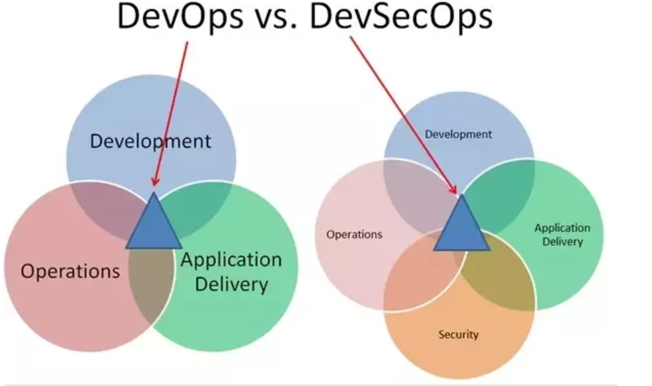
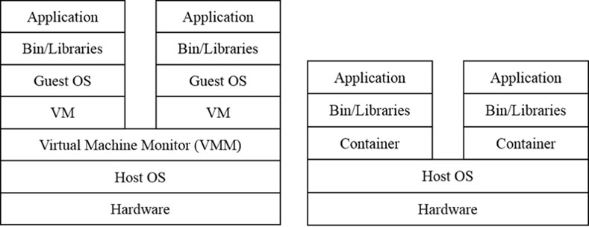
A typical stack for software containers
Figure shows a typical stack for software containers. It is compared with the stack of VMs to highlight the difference between these two virtualization technologies.
Result is significantly faster deployment, less overhead, easier migration, agile restart.
Figure: The Container Stack vs the VM Stack

Slide 100
The six important components of a DevSecOps Approach
Code Analysis
Change Management
Compliance Monitoring
Threat Investigation
Vulnerability Assessment
Security Training

Slide 101
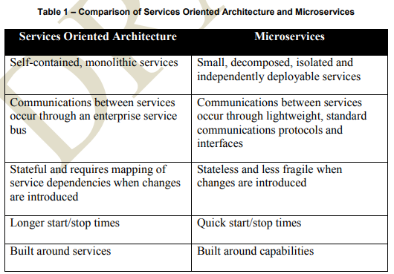

Slide 102
Refs. on Blockchain
[Agg17] D. Aggarwal et al., “Quatum attacks on Bitcoin, and how to protect against them”, arXiv:1710.10377v1, Oct. 2017
[Ell17] A. Ellervee, R. Matulevicius, N. Mayer, “A comprehensive reference model for blockchain-based distributed ledger technology”, Procs. of the ER Forum 2017, Valencia, Spain, Nov. 6-9, 2017
[Hei15] Ethan Heilman, Alison Kendler, Aviv Zohar, Sharon Goldberg, “Eclipse Attacks on Bitcoin’s Peer-to-Peer Network”, Procs. 24th USENIX Security Symposium, August 12–14, 2015, Washington, D.C.
[Min18] D. Minoli, B. Occhiogrosso, “Blockchain mechanisms for IoT security”, Internet of Things, 1-2 (2018), 1-13

Slide 103
Refs. on Blockchain II
[Swa14] M. Swan, “Blockchain: The IT of the future”, slides,
https://www.slideshare.net/lablogga/blockchain-the-information-
technology-of-the-future?qid=2014776d-4a66-4446-a5bd-
1aa52e4da765&v=&b=&from_search=4
[XuX17] X. Xu, I. Weber, M. Staples, L. Zhu, J. Bosch, L. Bass, C. Pautasso, P. Rimba, “A taxonomy of blockchain-based systems for architecture design”, 2017 IEEE Int. Conf. on Software Architecture, 243-252.
[Zhe17] Z.Zheng, S. Xie, H. Dai, X.Chen, H.Wang, “An overview of blockchain technology: Architecture, consensus, and future trends”,
2017 IEEE Int. Congress on Big Data, 557-564.

Slide 104
Refs. on Big Data
J. Akoka, I. Comyn-Wattiau, and N. Laoufi, “Research on Big Data – A systematic mapping study”, Computer Standards & Interfaces, vol. 54, no. Part 2, pp. 105–115, Nov. 2017.
Y. Demchenko, C. De Laat, and P. Membrey, ‘Defining architecture components of the Big Data Ecosystem’, on Collaboration Technologies and Systems (CTS), 2014 International Conference on, 2014, pp. 104–112.
[Mor18a] J. Moreno, M.A.Serrano, E. Fernandez-Medina, E.B.Fernandez, “Towards a Security Reference Architecture for Big Data”, 20th International Workshop On Design, Optimization, Languages and Analytical Processing of Big Data (DOLAP 2018) Colocated with EDBT/ICDT 2018, Vienna, Austria, March 26, 2018
[Mor18b] J Moreno, E Fernandez, E Fernandez-Medina, M Serrano, “A security pattern for NoSQL (key value pairs) database authorization, EuroPLoP 2018
NIST, “NIST Big Data Reference Architecture”. [Online]. Available: https://bigdatawg.nist.gov/_uploadfiles/M0639_v1_9796711131.d ocx. [Accessed: 18-Oct-2017]. [

Slide 105
References on AI and adaptive systems
[Adp18] Adpakkala (Daniel Pakkala), “Towards an Architecture Framework for AI Systems”,2018. https://opentechai.blog/2018/01/17/towards-an-architecture-framework-for-opentech-ai-systems/
Yoshua Bengio, “Learning Deep Architectures for AI”, https://www.iro.umontreal.ca/~bengioy/papers/ftml.pdf
[Chen02] Shang-Wen Cheng, David Garlan, Bradley Schmerl, João Pedro Sousa, Bridget Spitznagel, Peter Steenkiste, “Using Architectural Style as a Basis for System Self-repair”, In Software Architecture: System Design, Development, and Maintenance (Proceedings of the 3rd Working IEEE/IFIP Conference on Software Architecture), Kluwer Academic Publishers, August 25-31, 2002. pp. 45-59.
[Gar09] D. Garlan, B. Schmerl, S. Cheng, “Software architecture-based self-adaptation”, in Autonomic Computing and Networks (M. Denko, L. Yang, Y. Zhang, eds.), Springer 2009.

Slide 106
References on DevOPs and microservices
K. Beznosov, P. Kruchten, “Towards agile security assurance”, NSPW’04, Procs. of the 2004 Workshop on New Security Paradigms,
C. Fetzer, “Building critical applications using microservices”, Computer, IEEE, March 2017, 46-49.
M. Fowler, “Microservices’, https://martinfowler.com/articles/microservices.html
S. Newman, Building microservices, O’Reilly 2014
A.A.Rahman, L. Williams, “Security practices in DevOps”, https://akondrahman.github.io/papers/hotsos2016_devsecops.pdf

Slide 107
Facebook – search tool hack
On April 4, 2018 Facebook announced that its search tools were exploited by attackers
The hack happened over the course of several years, with few Facebook users likely escaping the scam
The abuse of the search tool made it possible for the hackers to discover the identities and collect information on most of its 2 billion users worldwide
Malicious hackers harvested email addresses and phone numbers on the so-called “Dark Web,” where criminals post information stolen from data breaches over the years.

Slide 108
Facebook – search tool hack
The hackers then used computer programs to feed the phone numbers and addresses into Facebook’s “search” box, allowing them to discover the full names of people affiliated with the phone numbers or addresses, along with whatever Facebook profile information they chose to make public, often including their profile photos and hometown.
Facebook users could have blocked this search function, by tweaking their settings to restrict finding their identities by using phone numbers or email addresses. But it was turned on by default.
Users of online platforms rarely adjust default privacy settings and often fail to understand what information they are sharing.

Slide 109
Facebook – search tool hack
Hackers also abused Facebook’s account recovery function, by pretending to be legitimate users who had forgotten account details.
This tool could also be blocked in privacy settings.
The Facebook hack allowed attackers to tie raw data to people’s real identities and build fuller profiles of them.

Slide 110
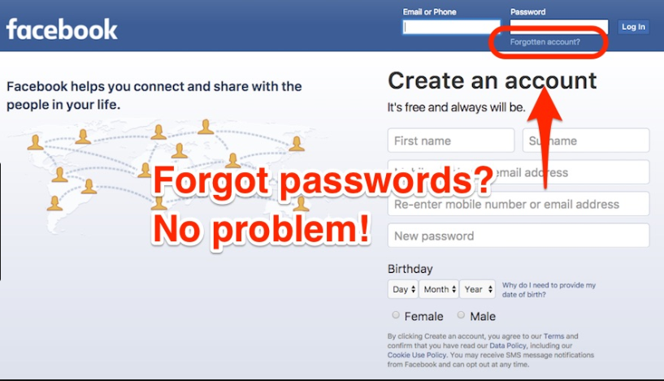
Stolen data from
‘Dark Web’
phone-number
address
automated programs
impersonating
Facebook search
Facebook account recovery
……
……

